Slide 1
EAS2655 – Week 8
Agenda
Data visualization
Making high quality, publishable figures
Working with NetCDF data
MATLAB vs. Python
Maps with different projections
Multi-panel plot

Slide 2
Data visualization
“A picture is worth a thousand words”
Figures are often the quickest way to communicate large amounts of complex information
Identify patterns, trends, outliers in large datasets
Important in all careers: academia, business, data science, …

Slide 3
Data visualization
Figures are a key component in scientific papers
Many readers will only look at figures and tables
Readers will only read your text only if they are attracted by your figures
High quality figures will give your work professional appearance
https://www.springer.com/gp/authors-editors/authorandreviewertutorials/writing-a-journal-manuscript/figures-and-tables/10285530

Slide 4
Preparing high quality figures
Scientific journals typically have specific requirements for artwork
General rules
Figure sizing
Fonts and labels
Colors
File formats
Resolution
…

Slide 5
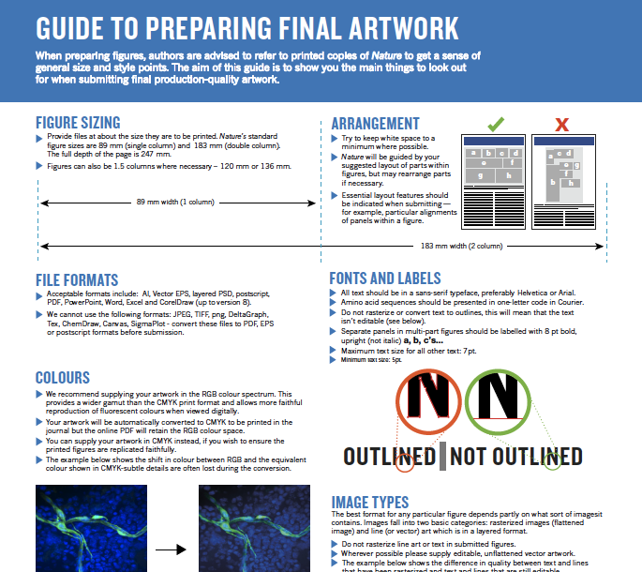
Nature’s guide to prepare final artwork
https://www.nature.com/documents/nature-final-artwork.pdf

Slide 6
Figure sizing
Single-column vs. double-column
US letter: 8.5” * 11”
Single column: width <= 3.5” (simple, single panel plots)
Double-column: width <= 7.2” (multiple panel plots, complex maps, etc)

Slide 7
Figure sizing
A plot consists of a figure object, and at least one axes object
Specify figure size when creating figure object (if needed)
Python (matplotlib)
fig=plt.figure(figsize=(3.5, 2.5)) # unit: inches
MATLAB
The following commands specify paper size, position of figure on the paper, margin, size, etc
figure1=figure('PaperType','usletter',...
'PaperPositionMode','manual','PaperUnits',...
'inches','PaperSize',[8.5 11],...
'PaperPosition',[2.5 2.5 3.5 2.5],'visible','on');

Slide 8
Add axes to figure
For a single panel plot, you may not need to specify axes position; useful when you plot multi-panel plots
Python (matplotlib)
fig=plt.figure(figsize=(3.5, 2.5)) # unit: inches
ax=fig.add_axes([0.1, 0.15, 0.8, 0.8])
MATLAB
ax= axes('Parent',fig,'LineWidth',1,...
'Layer','top','FontSize’,10,'FontName','Arial','box','off','color','none',...
'YAxisLocation','left','XAxisLocation','bottom',...
’position’,[0.1,0.15,0.8,0.8]);

Slide 9
Paper
Figure
ax=fig.add_axes([x,y,w,h])
Axes
ax= axes('Parent',fig,’position’,[x,y,w,h])
h
x
w
y

Slide 10
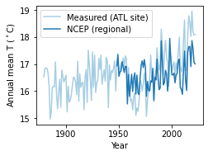
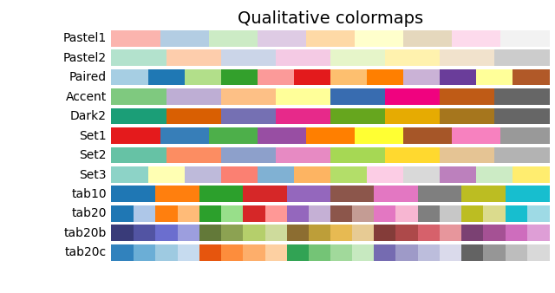
Choose colors (line plot)
Python (matplotlib)
cmap=plt.get_cmap('Paired’)
plt.plot(year,TMP_ATL_year_degC,label='Measured (ATL site)',color=cmap(0))

Slide 11
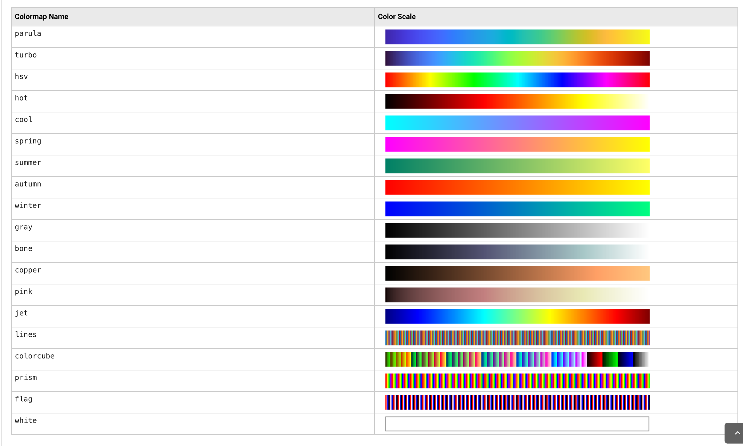
Choose colors (line plot)
MATLAB (with built-in colormaps)
cmap=lines(7);
plot(year,TMP_ATL_year_degC,'linewidth',1.5,'Displayname','Measured (ATL site)','color',cmap(1,:));

Slide 12
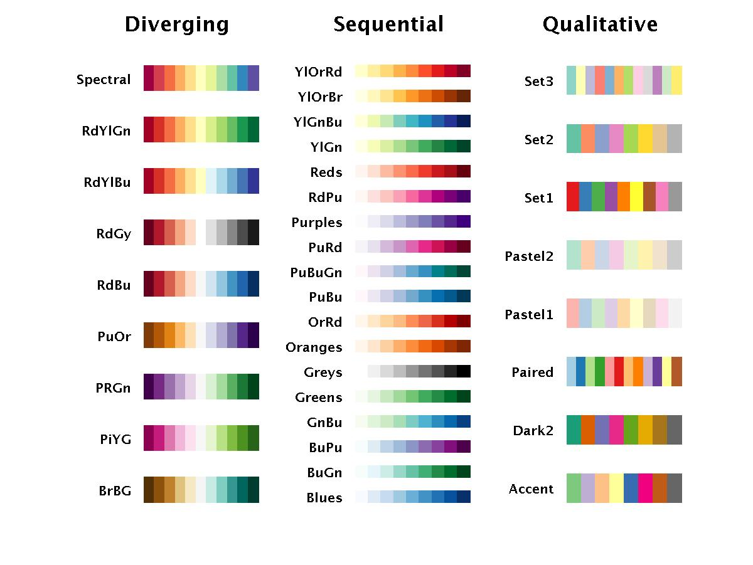
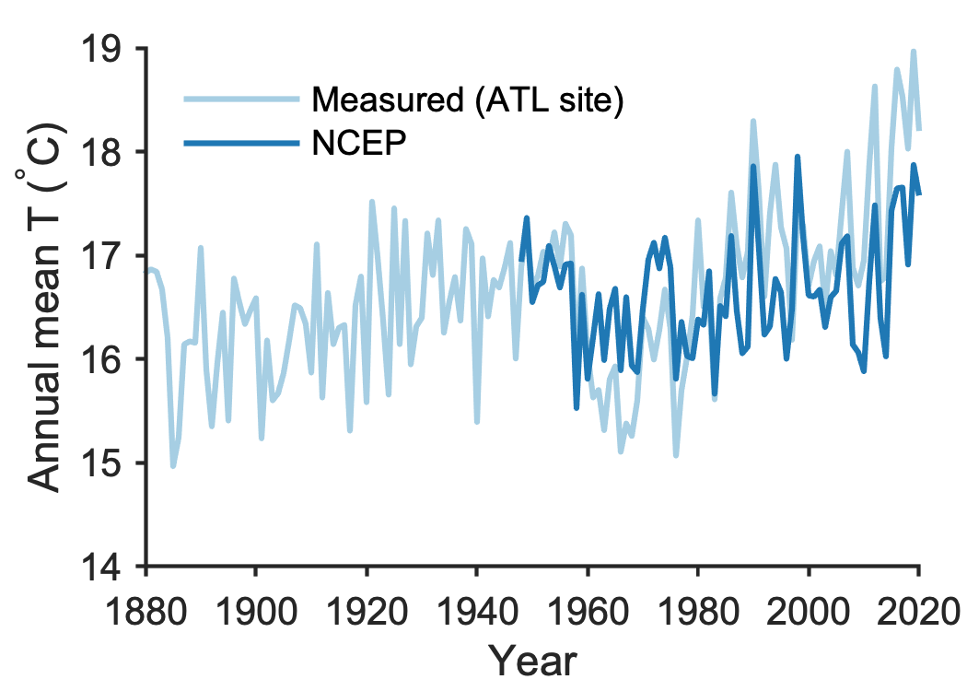
Choose colors (line plot)
MATLAB (with colorbrewer package)
cmap=cbrewer('qual','Paired',12);
plot(year,TMP_ATL_year_degC,'linewidth',1.5,'Displayname','Measured (ATL site)','color',cmap(1,:));

Slide 13
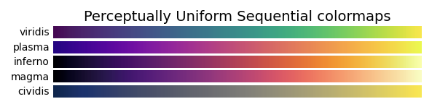
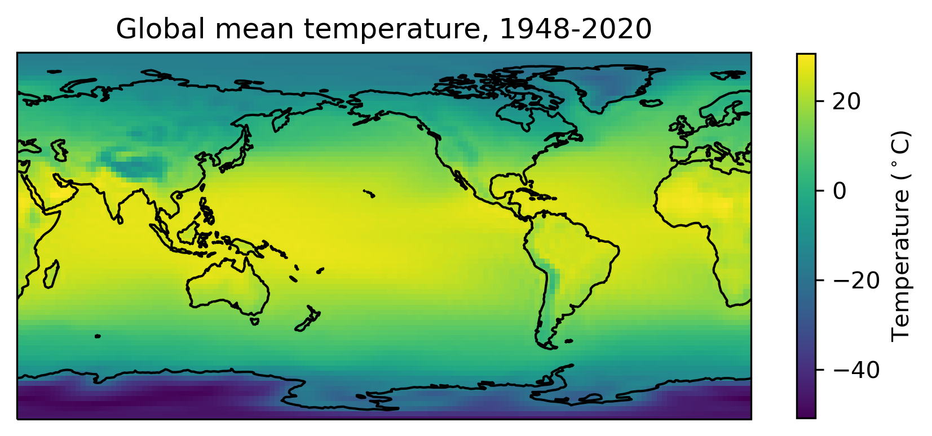
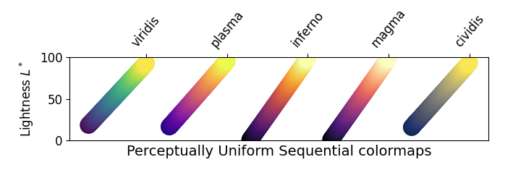
Choose colors (pcolor plot)
Perceptually uniform sequential colormaps (preferred)
Other sequential colormaps (acceptable)
Do not use jet or other rainbow-like color scales

Slide 14
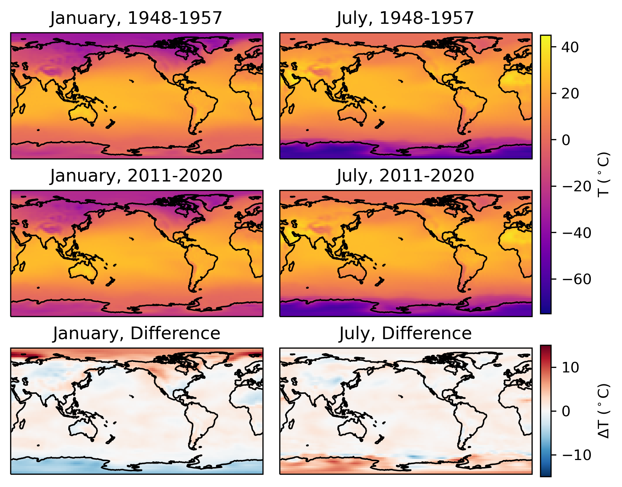
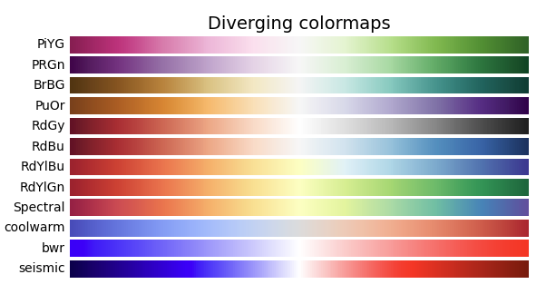
Choose colors (pcolor plot)
Use diverging colormaps to highlight data having both positive and negative values
To invert the order of colors:
Python: cmap=‘RdBu_r’
MATLAB: cmap=cbrewer('div','RdBu',128,'linear');
cmap2=flipud(cmap);
colormap(cmap2);

Slide 15
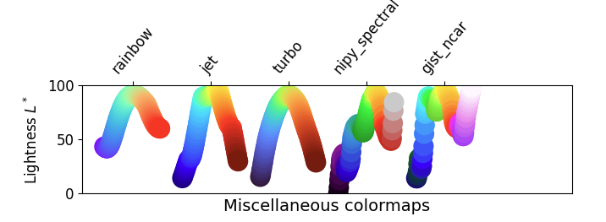
What is wrong with rainbow-like color maps (e.g., jet)?
Jet was the default colormap in MATLAB before v2014b
High contrast, high saturation, natural spectrum of sun light
Perceptually ambiguous (can be misleading), not colorblind-friendly
jet color map
https://journals.ametsoc.org/view/journals/bams/96/2/bams-d-13-00155.1.xml
https://www.nature.com/articles/s41467-020-19160-7

Slide 16
Save figure to file
Python (matplotlib)
fn='Fig_ATL_temp'
plt.savefig('./fig/'+fn+'.pdf',bbox_inches="tight",dpi=300)
plt.savefig('./fig/'+fn+'.png',bbox_inches="tight",dpi=300)
plt.show()
MATLAB
fn='Fig_ATL_temp';
print(fig,'-dpdf','-painters',['./fig/',fn,'.pdf']);
print(fig,'-dpng','-r300', ['./fig/',fn,'.png']);

Slide 17
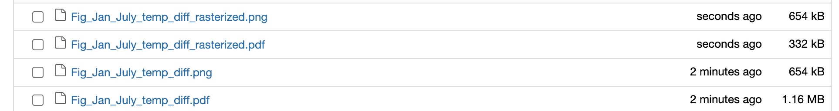
Rasterize your colored maps
Python (matplotlib)
Generally, vector format is preferred
The size of complex vector format figure can be overly large (> 5 Mb)
Save your colored maps in raster format, and keep other objects (coastal line, text, markers, etc) in vector format
cf=plt.pcolormesh(Xb,Yb,TMP_NCEP_JAN1.values, transform=ccrs.PlateCarree(),vmin=-75,vmax=45,cmap='plasma',rasterized=True)
…
plt.savefig('./fig/'+fn+'.pdf',bbox_inches="tight",dpi=300)

Slide 18
What is NetCDF data
NetCDF (Network Common Data Form)
A set of software libraries and machine-independent data formats that support the creation, access, and sharing of array-oriented scientific data
Developed by the Unidata project at the University Corporation for Atmospheric Research (UCAR)
File extensions: .nc,.nc4, .ncf, .ncdf, …
Climate model output, satellite data, etc

Slide 19
Why NetCDF
NetCDF (Network Common Data Form)
Self-Describing. A netCDF file includes information about the data it contains.
Portable. A netCDF file can be accessed by computers with different ways of storing integers, characters, and floating-point numbers.
Scalable. Small subsets of large datasets in various formats may be accessed efficiently through netCDF interfaces, even from remote servers.
Appendable. Data may be appended to a properly structured netCDF file without copying the dataset or redefining its structure.
Sharable. One writer and multiple readers may simultaneously access the same netCDF file.
Archivable. Access to all earlier forms of netCDF data will be supported by current and future versions of the software.
https://www.unidata.ucar.edu/software/netcdf/

Slide 20
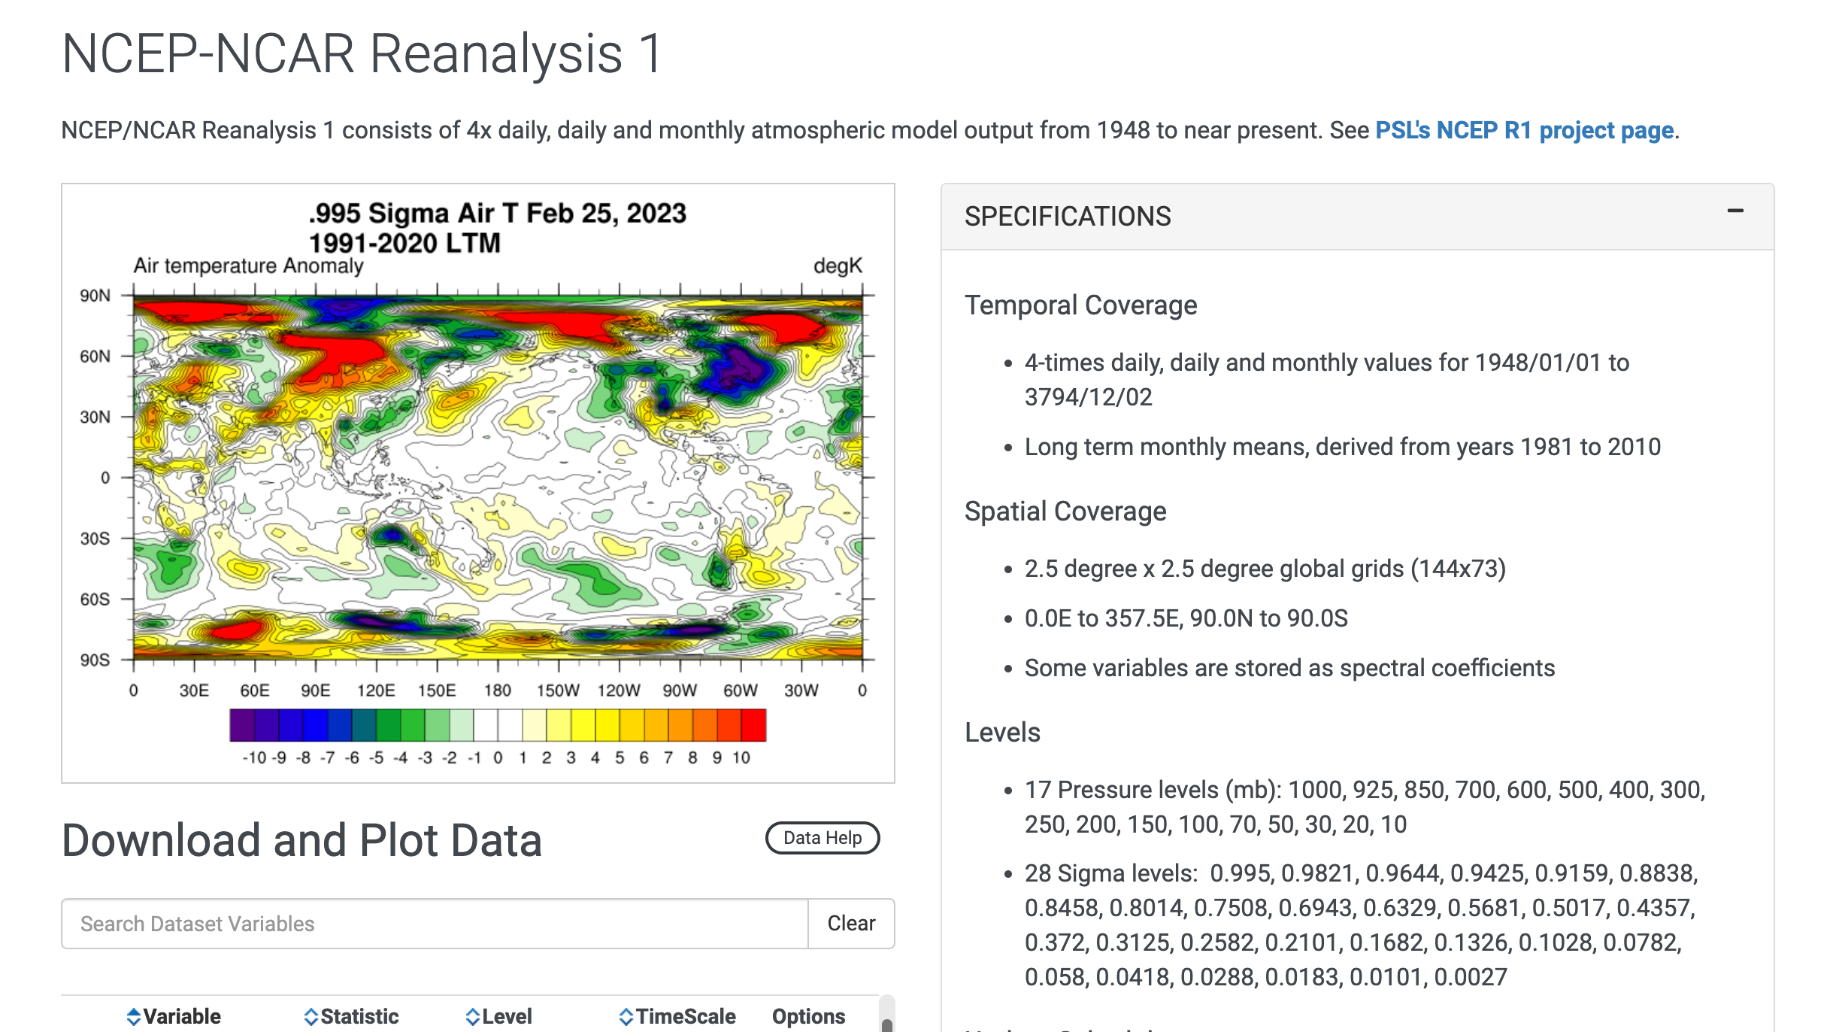
NetCDF example: NCEP dataset
Good resources for your final project, too!
https://psl.noaa.gov/data/gridded/data.ncep.reanalysis.html

Slide 21
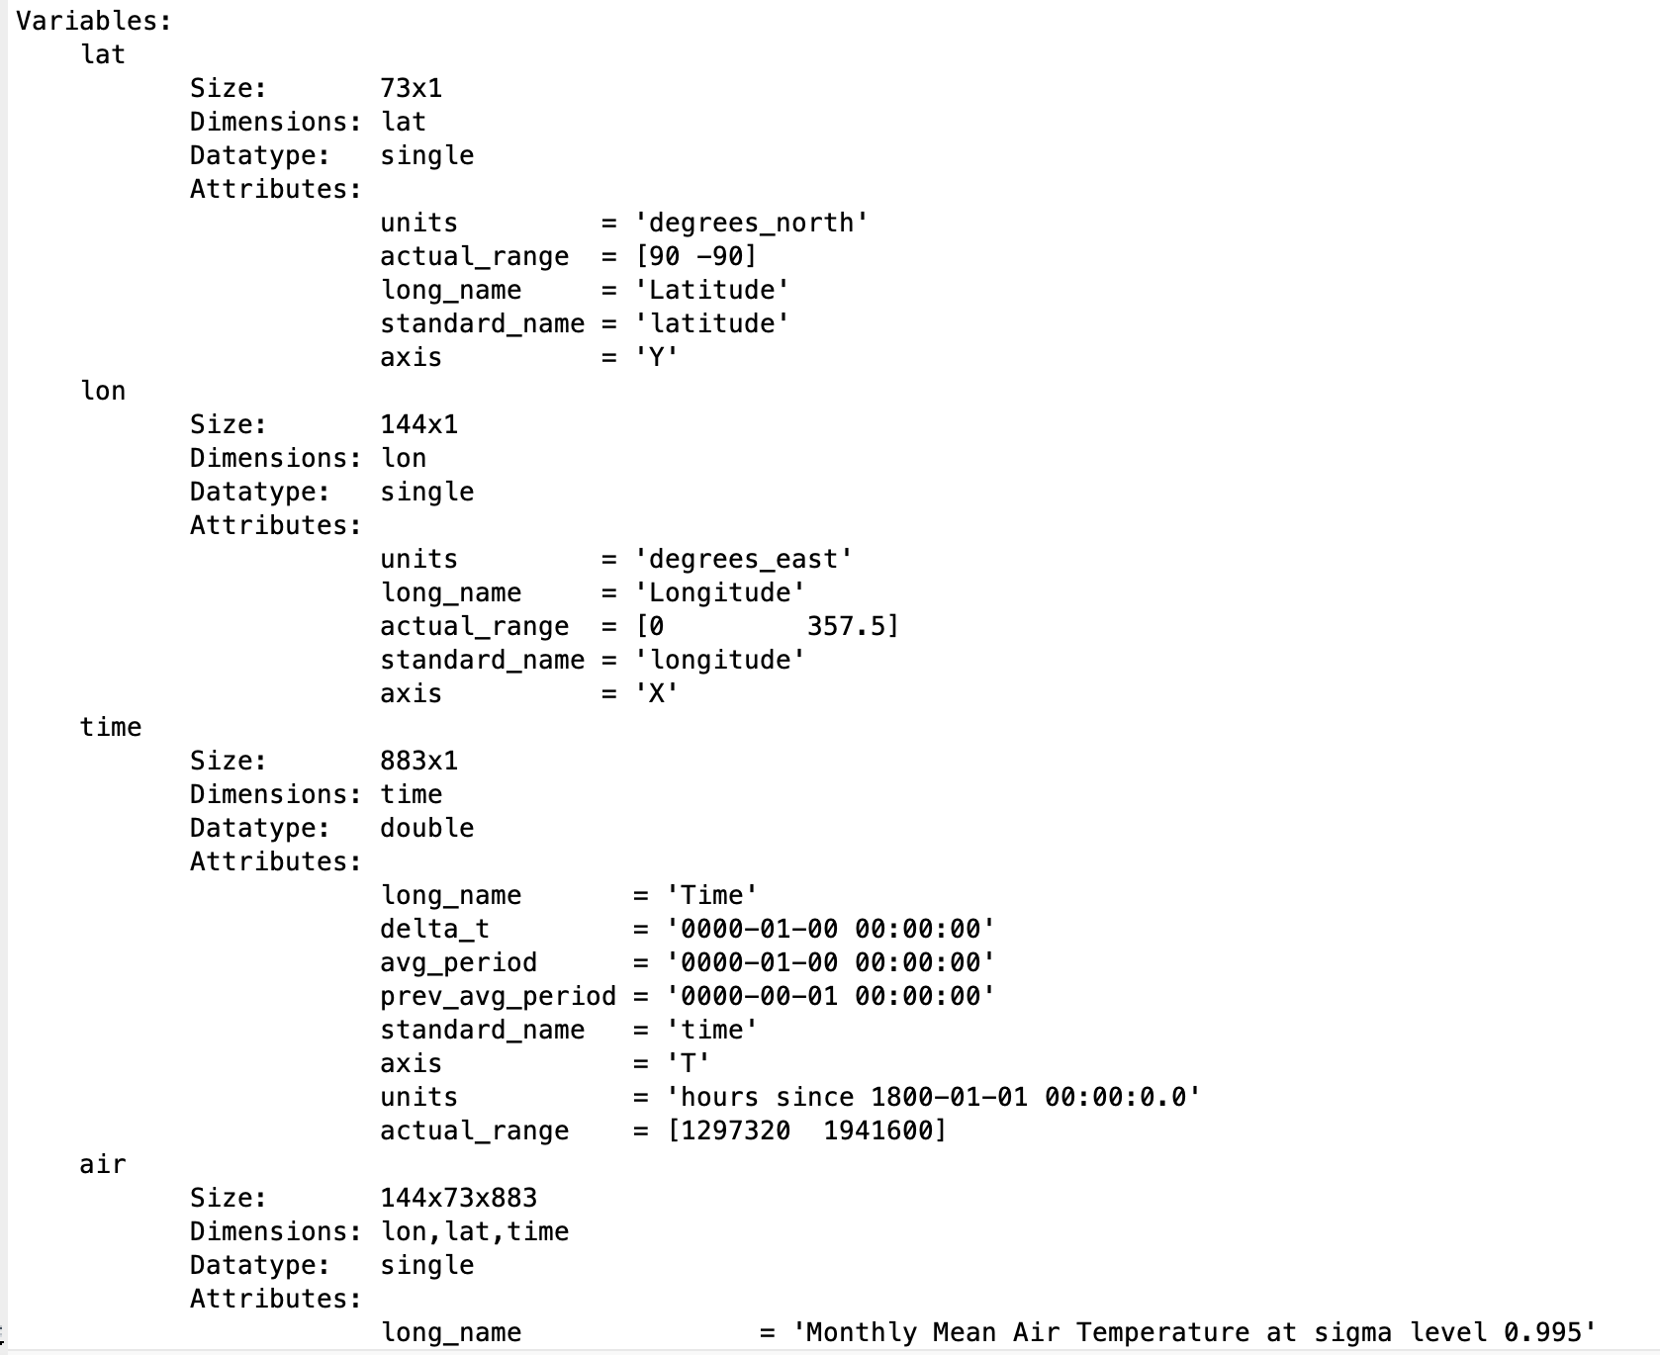
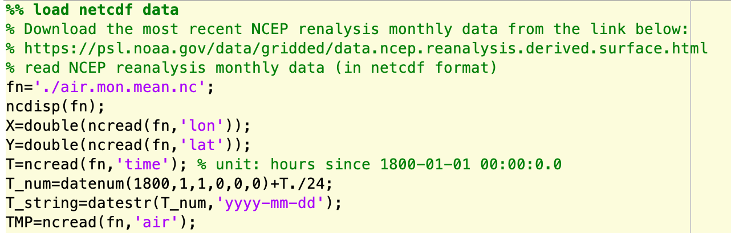
Exercise 1: Working with NetCDF data
MATLAB
Matrix-based

Slide 22
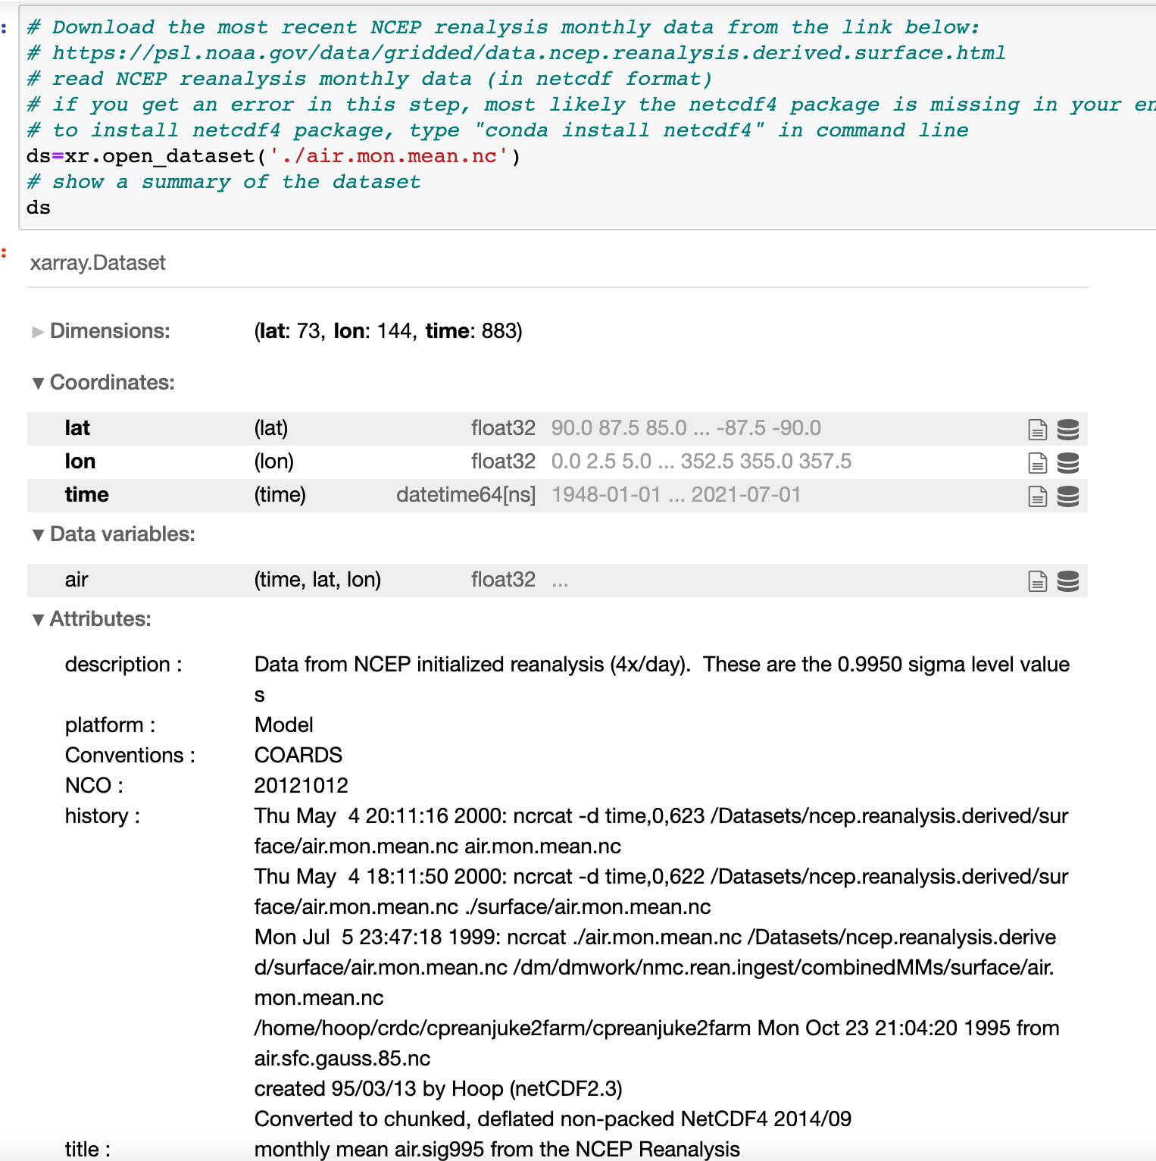
Exercise 1: Working with NetCDF data
Python
Object-oriented programming
Xarray package for NetCDF
Cartopy package for plotting maps

Slide 23
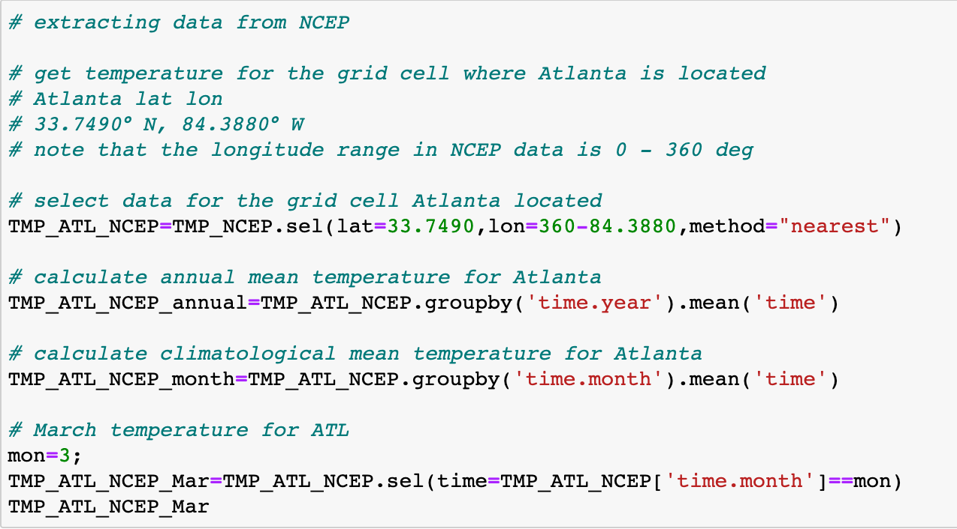
Exercise 1: Working with NetCDF data
Python
Xarray package

Slide 24
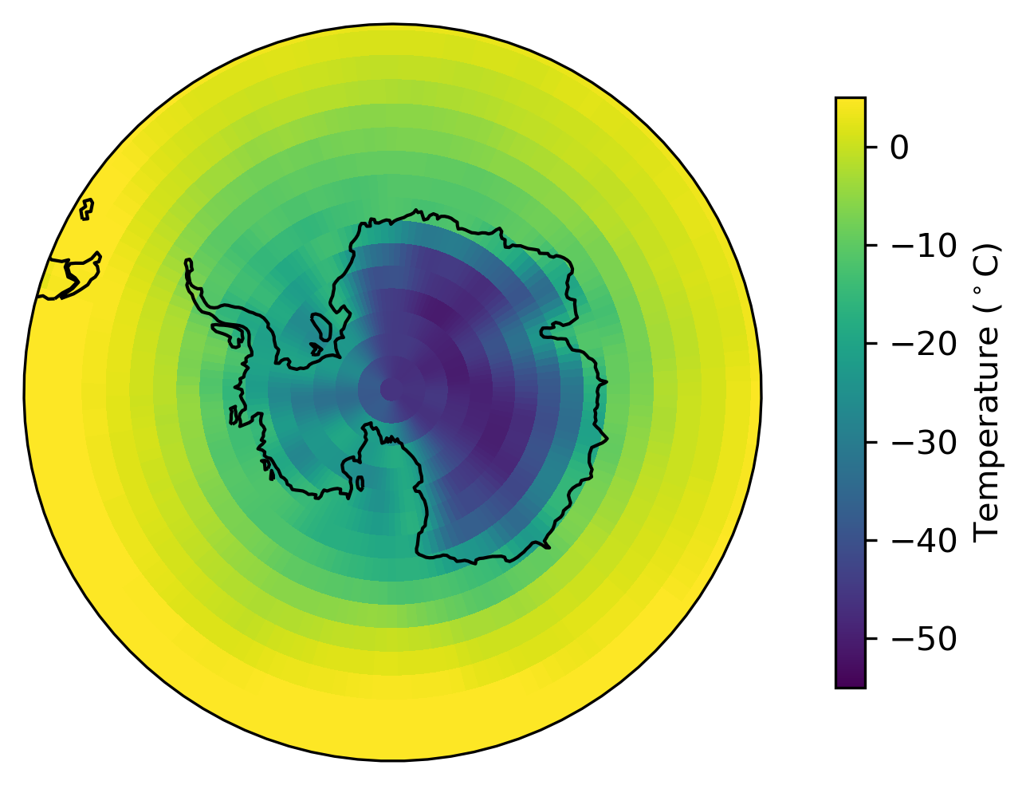
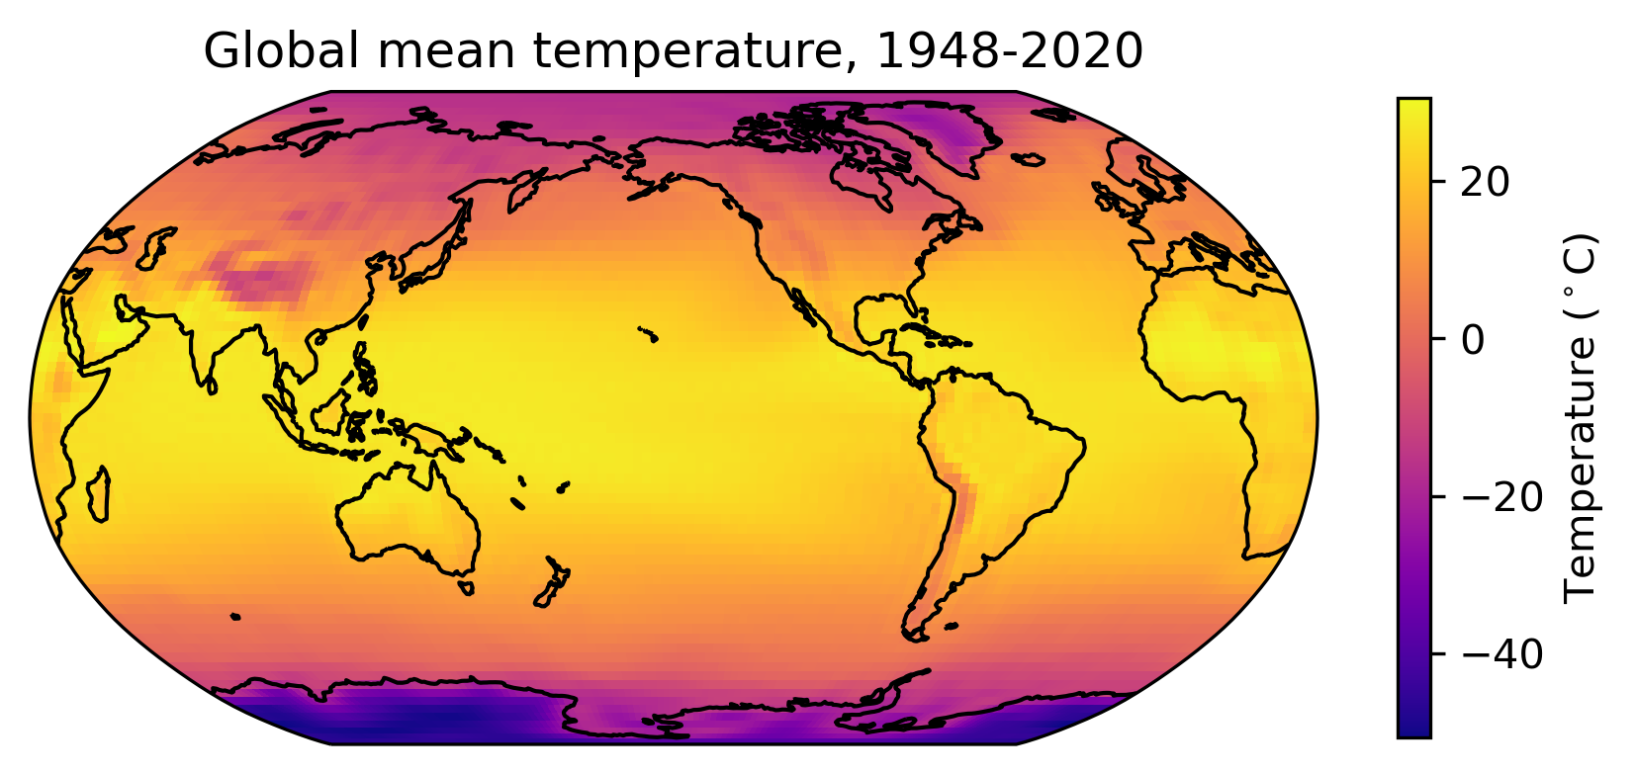
Exercise 2: Making global maps with different projections

